Slide 1
Chapter 9
Professional Ethics

Slide 2
Chapter Overview
Introduction
How well developed are the computing professions?
Software engineering code of ethics
Analysis of the code
Case studies
Whistle-blowing
1-<number>

Slide 3
9.1 Introduction
Informally, profession a vocation requiring…
  High level of education
  Practical experience
We pay professionals well
  Doctors
  Lawyers
We trust professionals to…
  Correctly ascertain and treat problems
  Take actions for the good of their clients
1-<number>

Slide 4
9.2 How Well Developed Are the Computing Professions?
1-<number>

Slide 5
Characteristics of a Profession
INITIAL PROFESSIONAL EDUCATION— formal course work completed by candidates before they begin practicing the profession
ACCREDITATION—a means of assuring that the formal course work meets the standards of the profession
SKILLS DEVELOPMENT— activities that provide candidates with the opportunity to gain practical skills needed to practice the profession
CERTIFICATION— a process by which candidates are evaluated to determine their readiness to enter the profession
1-<number>

Slide 6
Characteristics of a Profession
LICENSING— the process giving candidates the legal right to practice the profession
PROFESSIONAL DEVELOPMENT— formal course work completed by professionals in order to maintain and develop their knowledge and skills
CODE OF ETHICS— a mechanism by which a profession ensures that its members use their knowledge and skills for the benefit of society
PROFESSIONAL SOCIETY— an organization promoting the welfare of the profession, typically consisting of most, if not all, members of the profession
1-<number>

Slide 7
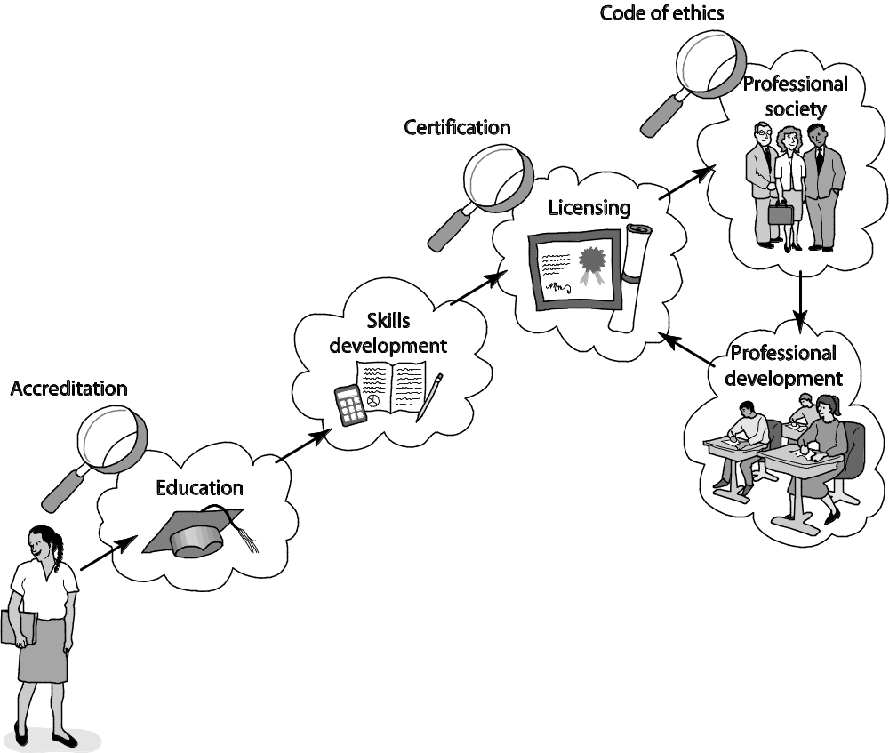
Attributes of a Mature Profession
1-<number>

Slide 8
Certified Public Accountants
Bachelor’s degree
  150+ semester hours
  24+ hours of accounting-related classes
Two years’ experience working under supervision of a CPA
CPA exam
To retain certification
  Continuing education
  Follow code of ethics
1-<number>

Slide 9
Computer-Related Careers
Certification and licensing not required
College degree not required
Apprenticeship not required
Membership in professional society optional
No specific requirements for continuing education
Most computer programmers, system analysts, etc. are part of teams
1-<number>

Slide 10
Status of Certification and Licensing
Two largest organizations supporting computing field
  Association for Computing Machinery (ACM)
  IEEE Computer Society (IEEE-CS)
Software engineer: someone engaged in development or maintenance of software, or teaches in this area
ACM opposed to licensing of software engineers at this time
  Move thought to be premature
  Wouldn’t be effective at improving quality and reliability of software
1-<number>

Slide 11
Ability to Harm Public
Many computer professionals hold responsibilities similar to those held by members of mature professions
Glitches have killed or gravely injured people
Millions rely upon software rather than accountants to prepare their tax returns
Millions of people rely on system administrators to keep their work-related information secure
1-<number>

Slide 12
The Importance of Taking Personal Responsibility
The ability to cause harm to members of the public is a powerful reason why those in computer-related careers must act according to ethical principles. Without formal certification and licensing and other components of a well-developed profession to rely upon, those in computer-related careers must take more personal responsibility for developing their ethical decision-making skills.
1-<number>

Slide 13
9.3 Software Engineering Code of Ethics
1-<number>

Slide 14
Preamble of Code
Software engineers have opportunities to do good or do harm
Software engineers ought to be committed to doing good
Eight principles identify key ethical relationships and obligations within these relationship
Code should be seen as a whole, not a collection of parts
Concern for the public interest is paramount
1-<number>

Slide 15
Eight Principles Identify Morally Responsible Relationships
Public
Client and employer
Product
Judgment
Management
Profession
Colleagues
Self
1-<number>

Slide 16
Act Consistently with Public Interest
1.01 “Accept full responsibility for own work”
1.02 Balance competing interests
1.03 Approve software only if it is safe
1.04 Disclose actual/potential dangers
1.05 “Cooperate in efforts to address” public concerns
1.06 “Be fair and avoid deception in all statements”
1.07 Consider factors that diminish access to software
1.08 “Volunteer professional skills to good causes”
1-<number>

Slide 17
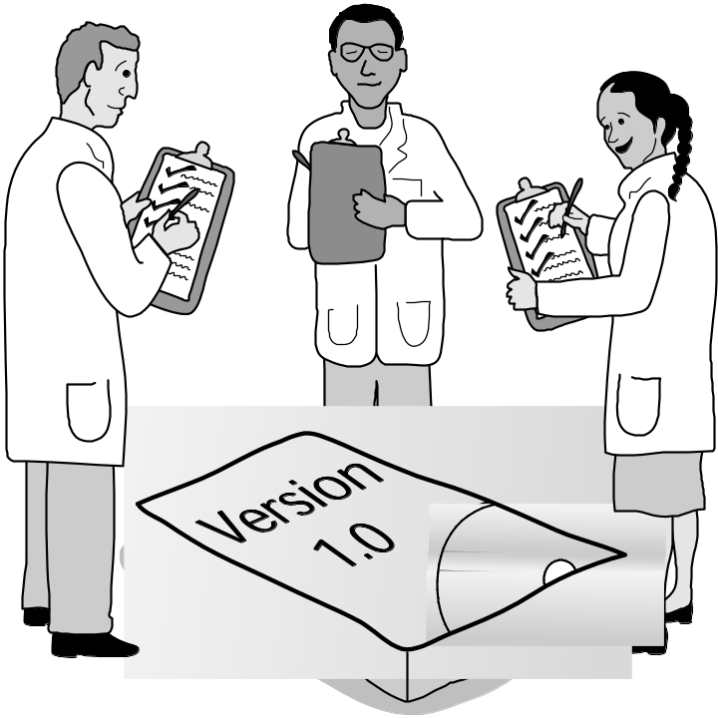
Clause 1.03
Approve Software Only If It Is Safe
1-<number>

Slide 18
Act in Best Interest of Client, Employer
2.01 Act within areas of competence
2.02 Don’t use software obtained illegally
2.03 Only use property in authorized ways
2.04 Ensure documents are approved
2.05 Respect confidentiality
2.06 Promptly report problems with project
2.07 Report issues of social concern
2.08 Refuse outside work detrimental to job
2.09 Put employer’s/client’s interests first, unless overriding moral concern
1-<number>

Slide 19
Act in Best Interest of Client, Employer
2.01 Act within areas of competence
2.02 Don’t use software obtained illegally
2.03 Only use property in authorized ways
2.04 Ensure documents are approved
2.05 Respect confidentiality
2.06 Promptly report problems with project
2.07 Report issues of social concern
2.08 Refuse outside work detrimental to job
2.09 Put employer’s/client’s interests first, unless overriding moral concern
1-<number>

Slide 20
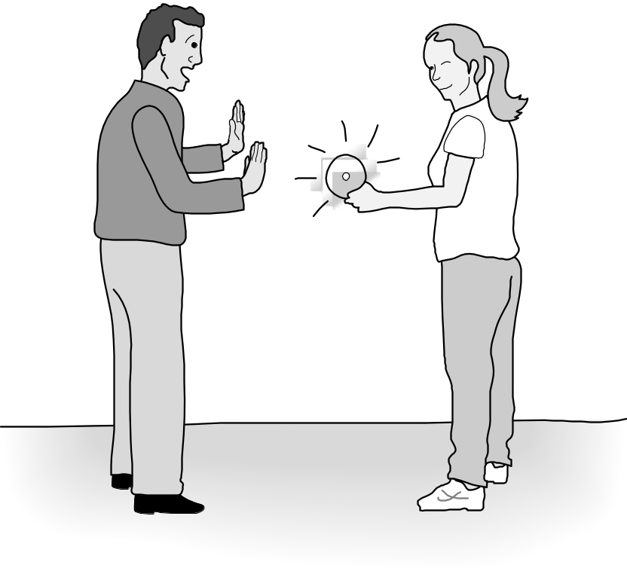
Clause 2.02
Don’t Use Software Obtained Illegally
1-<number>

Slide 21
Ensure Products Meet Highest Standards
3.01 Aim for “high quality, acceptable cost and a reasonable schedule,” making trade-offs clear
3.02 “Ensure proper and achievable goals”
3.03 Face up to “ethical, economic, cultural, legal and environmental” issues
3.04 Ensure you are qualified for proposed work
3.05 Use appropriate project methodologies
3.06 Follow the most appropriate professional standards
3.07 “Strive to fully understand the specifications”
3.08 Ensure the specifications are correct and approved
1-<number>

Slide 22
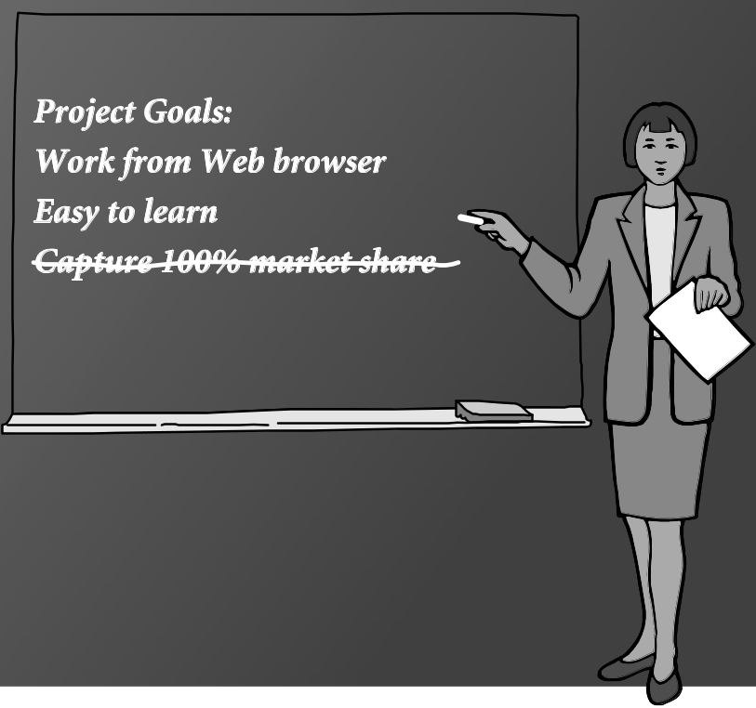
Clause 3.02
“Ensure Proper and Achievable Goals”
1-<number>

Slide 23
Ensure Products Meet Highest Standards
3.09 “Ensure realistic quantitative estimates of cost, scheduling, personnel, quality and outcomes”
3.10 “Ensure adequate testing, debugging, and review of software and related documents”
3.11 “Ensure adequate documentation”
3.12 Develop software and documents that respect privacy of those affected by software
3.13 Use only accurate data appropriately acquired
3.14 Maintain data integrity
3.15 Use same standards for software maintenance as software development
1-<number>

Slide 24
Maintain Integrity in Professional Judgment
4.01 “Temper all technical judgments by the need to support and maintain human values”
4.02 Understand and agree with documents before endorsing them
4.03 Remain objective when evaluating software or related documents
4.04 Do not engage in deceptive financial practices
4.05 Disclose conflicts of interest
4.06 Do not participate in decisions in which you, your employer, or your client has a potential conflict of interest
1-<number>

Slide 25
Promote Effective Project Management
5.01 Ensure good project management procedures
5.02 Ensure software engineers know standards
5.03 Ensure software engineers know policies and procedures for protecting confidential information
5.04 Take employees’ abilities into account before assigning work
5.05 Ensure reasonable estimates are made
5.06 Give full and accurate information to potential employees
1-<number>

Slide 26
Promote Effective Project Management
5.07 Pay employees fairly
5.08 Do not unjustly prevent a qualified person from taking a job
5.09 Work out fair intellectual property agreements
5.10 Provide employees charged with misconduct due process
5.11 Do not ask someone to do anything violating the Code
5.12 “Do not punish anyone for expressing ethical concerns about a project”
1-<number>

Slide 27
Advance the Profession
6.01 Help create an environment supporting ethical conduct
6.02 “Promote public knowledge of software engineering”
6.03 Participate in professional activities
6.04 Support others who are trying to follow this Code
6.05 Do not promote self-interest at expense of profession, client, or employer
6.06 Obey all laws unless there is an overriding public interest
6.07 Do not deceive others regarding the characteristics of software
1-<number>

Slide 28

Clause 6.01 Help Create An Environment Supporting Ethical Conduct
1-<number>

Slide 29
Alternative List of Fundamental
Principles
Be impartial.
Disclose information that others ought to know.
Respect the rights of others.
Treat others justly.
Take responsibility for your actions and inactions.
Take responsibility for the actions of those you supervise.
Maintain your integrity.
Continually improve your abilities.
Share your knowledge, expertise, and values.
1-<number>

Slide 30
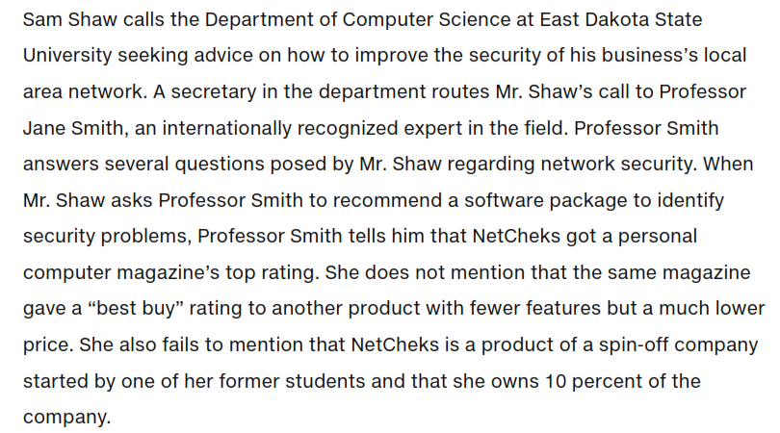
1-<number>

Slide 31
Whistle-Blowing
Whistle-blower is someone who breaks ranks with an organization in order to make an unauthorized disclosure of information about a harmful situation after attempts to report the concerns through authorized organizational channels have been ignored or rebuffed.
1-<number>

Slide 32
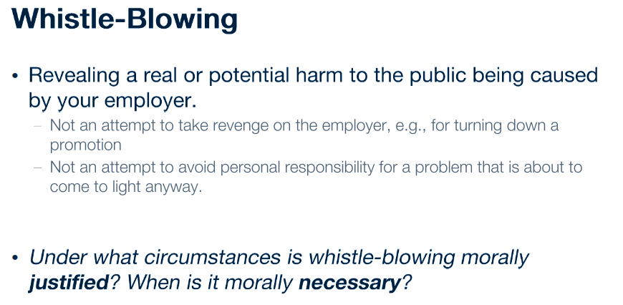
1-<number>

Slide 33
Morality of Whistle-Blowing
Whistle-Blowers Cause Harm
Whistle-Blowing is a Sign of
Organizational Failure
Whistle-Blowing as a Moral Duty
1-<number>

Slide 34
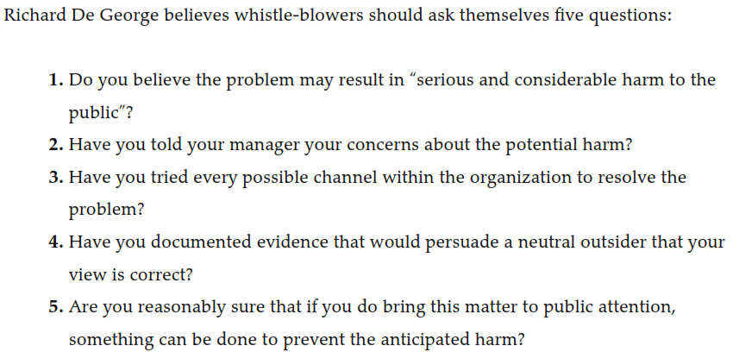
1-<number>

